Slide 1

Chapter 10
Two-Sample Tests
and
One-Way ANOVA

Slide 2
Objectives
In this chapter, you learn:
How to use hypothesis testing for comparing the difference between
  The means of two independent populations
  The means of two related populations
  The proportions of two independent populations
  The variances of two independent populations
  The means of more than two populations

Slide 3
Two-Sample Tests
DCOVA
Two-Sample Tests
Population Means, Independent Samples
Population Means, Related Samples
Population Proportions
Population Variances
Examples:
Group 1 vs. Group 2
Same group before vs. after treatment
Proportion 1 vs. Proportion 2
Variance 1 vs.
Variance 2

Slide 4
Difference Between Two Means
DCOVA
Population means, independent samples
*
Goal: Test hypothesis or form a confidence interval for the difference between two population means, μ₁ – μ₂
σ₁ and σ₂ unknown, assumed equal
The point estimate for the difference is
X₁ – X₂
σ₁ and σ₂ unknown, not assumed equal

Slide 5
Difference Between Two Means: Independent Samples
DCOVA
Different data sources
  Unrelated
  Independent
    Sample selected from one population has no effect on the sample selected from the other population
Population means, independent samples
*
Use S_{p} to estimate unknown σ. Use a Pooled-Variance t test.
σ₁ and σ₂ unknown, assumed equal
σ₁ and σ₂ unknown, not assumed equal
Use S₁ and S₂ to estimate unknown σ₁ and σ₂. Use a Separate-variance t test

Slide 6
Hypothesis Tests for
Two Population Means
DCOVA
Two Population Means, Independent Samples
Lower-tail test:
H₀: μ₁ ≥ μ₂
H₁: μ₁ < μ₂
i.e.,
H₀: μ₁ – μ₂ ≥ 0
H₁: μ₁ – μ₂ < 0
Upper-tail test:
H₀: μ₁ ≤ μ₂
H₁: μ₁ > μ₂
i.e.,
H₀: μ₁ – μ₂ ≤ 0
H₁: μ₁ – μ₂ > 0
Two-tail test:
H₀: μ₁ = μ₂
H₁: μ₁ ≠ μ₂
i.e.,
H₀: μ₁ – μ₂ = 0
H₁: μ₁ – μ₂ ≠ 0

Slide 7
Hypothesis tests for μ₁ – μ₂
DCOVA
Two Population Means, Independent Samples
Lower-tail test:
H₀: μ₁ – μ₂ ≥ 0
H₁: μ₁ – μ₂ < 0
Upper-tail test:
H₀: μ₁ – μ₂ ≤ 0
H₁: μ₁ – μ₂ > 0
Two-tail test:
H₀: μ₁ – μ₂ = 0
H₁: μ₁ – μ₂ ≠ 0
α
α
α/2
α/2
-t_{α}
t_{α}
-t_{α/2}
t_{α/2}
Reject H₀ if t_{STAT} < -t_{α}
Reject H₀ if t_{STAT} > t_{α}
Reject H₀ if t_{STAT} < -t_{α/2}
or t_{STAT} > t_{α/2}

Slide 8
Hypothesis tests for µ₁ - µ₂ with σ₁ and σ₂ unknown and assumed equal
DCOVA
Population means, independent samples
Assumptions:
Samples are randomly and
independently drawn
Populations are normally
distributed or both sample
sizes are at least 30
Population variances are
unknown but assumed equal
*
σ₁ and σ₂ unknown, assumed equal
σ₁ and σ₂ unknown, not assumed equal

Slide 9
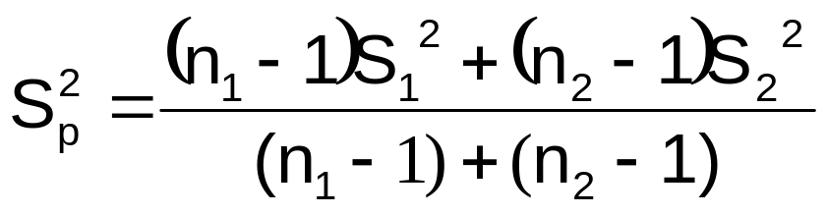
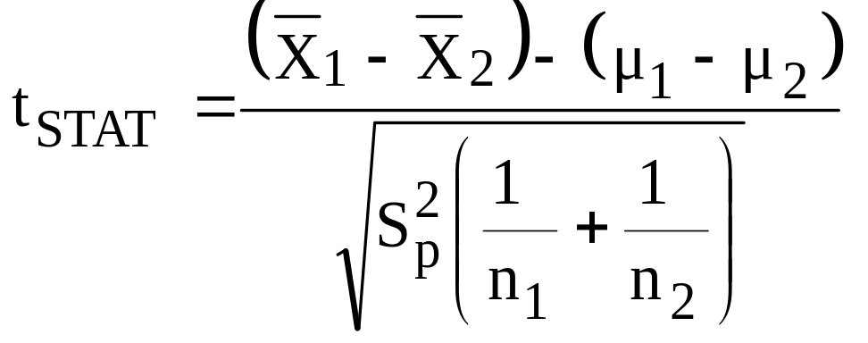
Hypothesis tests for µ₁ - µ₂ with σ₁ and σ₂ unknown and assumed equal
(continued)
DCOVA
The pooled variance is:
The test statistic is:
Where t_{STAT} has d.f. = (n₁ + n₂ – 2)
Population means, independent samples
*
σ₁ and σ₂ unknown, assumed equal
σ₁ and σ₂ unknown, not assumed equal

Slide 10
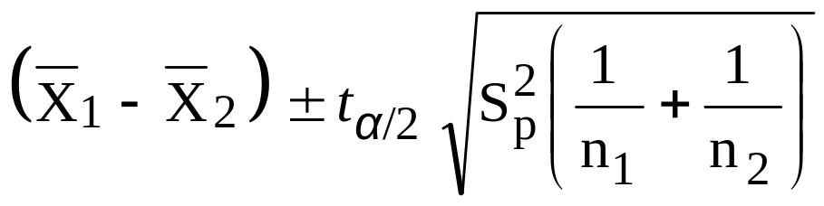
Confidence interval for µ₁ - µ₂ with σ₁ and σ₂ unknown and assumed equal
DCOVA
Population means, independent samples
The confidence interval for
μ₁ – μ₂ is:
Where t_{α/2} has d.f. = n₁ + n₂ – 2
*
σ₁ and σ₂ unknown, assumed equal
σ₁ and σ₂ unknown, not assumed equal

Slide 11

Pooled-Variance t Test Example
DCOVA
You are a financial analyst for a brokerage firm. Is there a difference in dividend yield between stocks listed on the NYSE & NASDAQ? You collect the following data:
NYSE NASDAQ
Number 21 25
Sample mean 3.27 2.53
Sample std dev 1.30 1.16
Assuming both populations are
approximately normal with equal variances, is
there a difference in mean
yield (α = 0.05)?

Slide 12
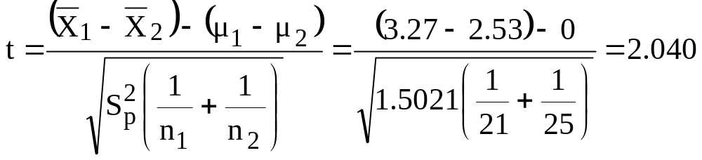
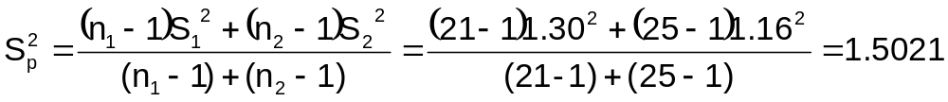
Pooled-Variance t Test Example: Calculating the Test Statistic
(continued)
H0: μ₁ - μ₂ = 0 i.e. (μ₁ = μ₂)
H1: μ₁ - μ₂ ≠ 0 i.e. (μ₁ ≠ μ₂)
DCOVA
The test statistic is:

Slide 13
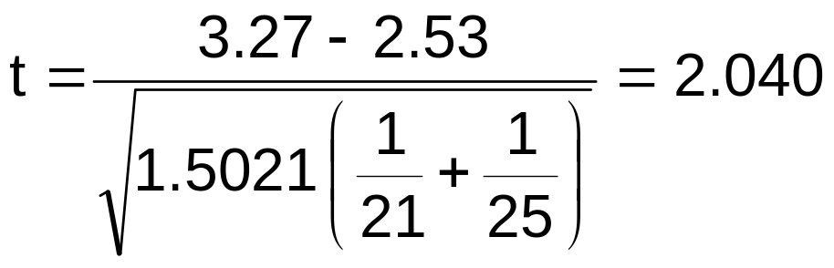
Pooled-Variance t Test Example: Hypothesis Test Solution
DCOVA
H₀: μ₁ - μ₂ = 0 i.e. (μ₁ = μ₂)
H₁: μ₁ - μ₂ ≠ 0 i.e. (μ₁ ≠ μ₂)
α = 0.05
df = 21 + 25 - 2 = 44
Critical Values: t = ± 2.0154
Test Statistic:
Reject H₀
Reject H₀
.025
.025
-2.0154
0
2.0154
t
2.040
Decision:
Conclusion:
Reject H₀ at α = 0.05
There is evidence of a difference in means.

Slide 14
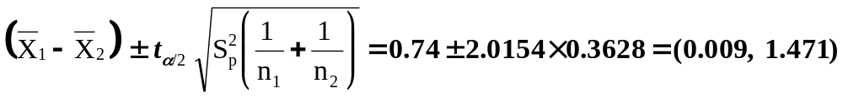
Pooled-Variance t Test Example: Confidence Interval for µ₁ - µ₂
DCOVA
Since we rejected H₀ can we be 95% confident that µ_{NYSE} > µ_{NASDAQ}?
95% Confidence Interval for µ_{NYSE} - µ_{NASDAQ}
Since 0 is less than the entire interval, we can be 95% confident that µ_{NYSE} > µ_{NASDAQ}

Slide 15
Hypothesis tests for µ₁ - µ₂ with σ₁ and σ₂ unknown, not assumed equal
DCOVA
Population means, independent samples
Assumptions:
Samples are randomly and
independently drawn
Populations are normally
distributed or both sample
sizes are at least 30
Population variances are
unknown and cannot be
assumed to be equal
σ₁ and σ₂ unknown, assumed equal
*
σ₁ and σ₂ unknown, not assumed equal

Slide 16
Hypothesis tests for µ₁ - µ₂ with σ₁ and σ₂ unknown and not assumed equal
(continued)
DCOVA
Population means, independent samples
The formulae for this test are not covered in this book.
See reference 8 from this chapter for more details.
This test utilizes two separate sample variances to estimate the degrees of freedom for the t test
σ₁ and σ₂ unknown, assumed equal
*
σ₁ and σ₂ unknown, not assumed equal

Slide 17
Separate-Variance t Test Example
DCOVA
You are a financial analyst for a brokerage firm. Is there a difference in dividend yield between stocks listed on the NYSE & NASDAQ? You collect the following data:
NYSE NASDAQ
Number 21 25
Sample mean 3.27 2.53
Sample std dev 1.30 1.16
Assuming both populations are
approximately normal with unequal variances, is
there a difference in mean
yield (α = 0.05)?

Slide 18
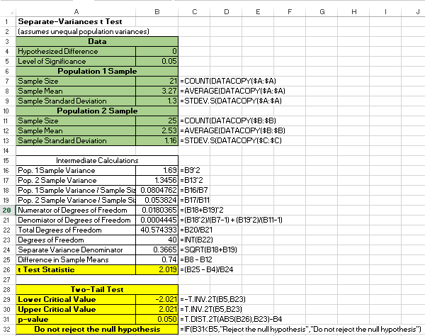
Separate-Variance t Test Example: Calculating the Test Statistic
(continued)
H0: μ₁ - μ₂ = 0 i.e. (μ₁ = μ₂)
H1: μ₁ - μ₂ ≠ 0 i.e. (μ₁ ≠ μ₂)
DCOVA

Slide 19

Separate-Variance t Test Example: Hypothesis Test Solution
DCOVA
H₀: μ₁ - μ₂ = 0 i.e. (μ₁ = μ₂)
H₁: μ₁ - μ₂ ≠ 0 i.e. (μ₁ ≠ μ₂)
α = 0.05
df = 40
Critical Values: t = ± 2.021
Test Statistic:
Reject H₀
Reject H₀
.025
.025
-2.021
0
2.021
t
2.019
Decision:
Conclusion:
Fail To Reject H₀ at α = 0.05
There is insufficient evidence of a difference in means.

Slide 20
Related Populations
The Paired Difference Test
DCOVA
Tests Means of 2 Related Populations
      Paired or matched samples
      Repeated measures (before/after)
      Use difference between paired values:
Eliminates Variation Among Subjects
Assumptions:
  Differences are normally distributed
  Or, if not Normal, use large samples
Related samples
  D_{i} = X_{1i} - X_{2i}

Slide 21
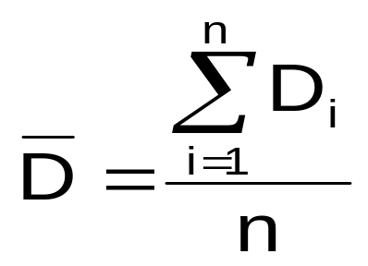
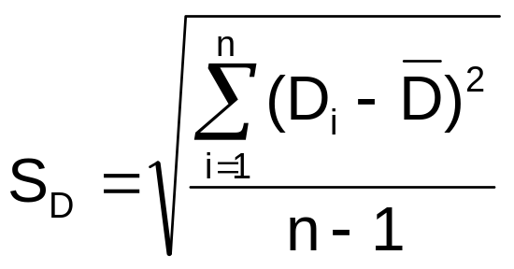
Related Populations
The Paired Difference Test
(continued)
DCOVA
The i^{th} paired difference is D_{i} , where
Related samples
  D_{i} = X_{1i} - X_{2i}
The point estimate for the paired difference population mean μ_{D} is D :
The sample standard deviation is S_{D}
n is the number of pairs in the paired sample

Slide 22
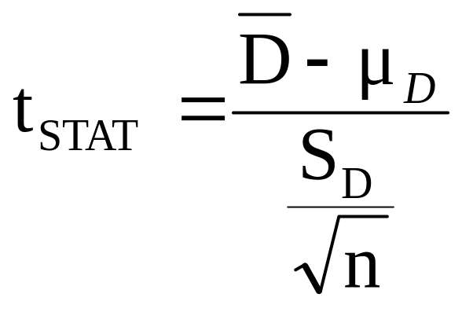
The Paired Difference Test:
Finding t_{STAT}
DCOVA
The test statistic for μ_{D} is:
Paired samples
Where t_{STAT} has n - 1 d.f.

Slide 23
The Paired Difference Test: Possible Hypotheses
DCOVA
Paired Samples
Lower-tail test:
H₀: μ_{D} ≥ 0
H₁: μ_{D} < 0
Upper-tail test:
H₀: μ_{D} ≤ 0
H₁: μ_{D} > 0
Two-tail test:
H₀: μ_{D} = 0
H₁: μ_{D} ≠ 0
α
α
α/2
α/2
-t_{α}
t_{α}
-t_{α/2}
t_{α/2}
Reject H₀ if t_{STAT} < -t_{α}
Reject H₀ if t_{STAT} > t_{α}
Reject H₀ if t_{STAT} < -t_{α/2}
or t_{STAT} > t_{α/2}
Where t_{STAT} has n - 1 d.f.

Slide 24
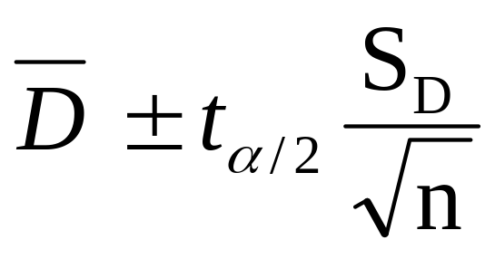
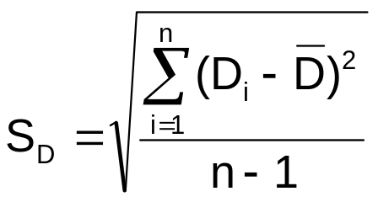
The Paired Difference Confidence Interval
DCOVA
The confidence interval for μ_{D} is
Paired samples
where

Slide 25
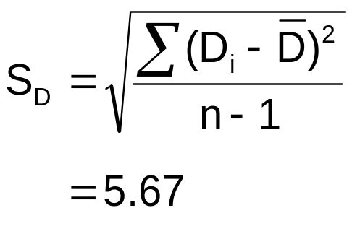
Paired Difference Test: Example
DCOVA
Assume you send your salespeople to a “customer service” training workshop. Has the training made a difference in the number of complaints? You collect the following data:
Number of Complaints: (2) - (1)
Salesperson Before (1) After (2) Difference, D_{i}
C.B. 6 4 - 2
T.F. 20 6 -14
M.H. 3 2 - 1
R.K. 0 0 0
M.O. 4 0 - 4
-21
Σ
D_{i}
D =
n
= -4.2

Slide 26
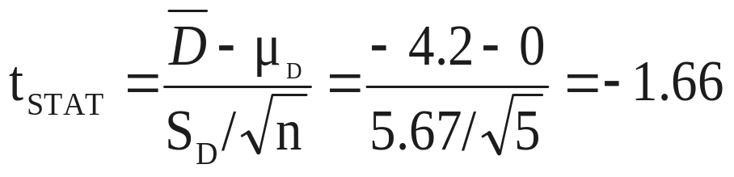
Paired Difference Test: Solution
DCOVA
Has the training made a difference in the number of complaints (at the 0.01 level)?
Reject
Reject
H₀: μ_{D} = 0
H₁: μ_{D} ≠ 0
α/2
α/2
α = .01
D =
- 4.2
- 4.604 4.604
- 1.66
t_{0.005} = ± 4.604 d.f. = n - 1 = 4
Decision: Do not reject H₀
(t_{stat} is not in the rejection region)
Test Statistic:
Conclusion: There is insufficient of a change in the number of complaints.

Slide 27
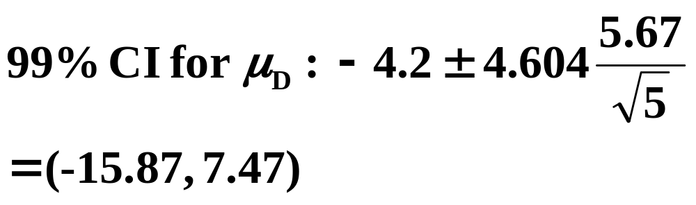
The Paired Difference Confidence Interval -- Example
DCOVA
The confidence interval for μ_{D} is:
Since this interval contains 0 you are 99% confident that μ_{D} = 0
D = -4.2, S_{D} = 5.67

Slide 28
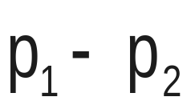
Two Population Proportions
DCOVA
Goal: test a hypothesis or form a confidence interval for the difference between two population proportions, π₁ – π₂
Population proportions
Assumptions:
n₁ π₁ ≥ 5 , n₁(1- π₁) ≥ 5
n₂ π₂ ≥ 5 , n₂(1- π₂) ≥ 5
The point estimate for the difference is

Slide 29
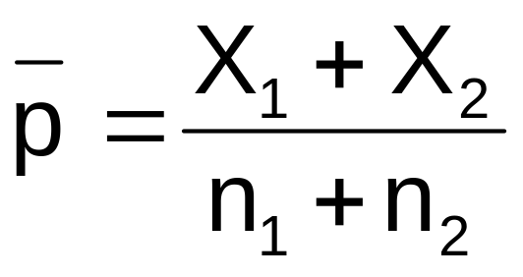
Two Population Proportions
DCOVA
In the null hypothesis we assume the null hypothesis is true, so we assume π₁ = π₂ and pool the two sample estimates
Population proportions
The pooled estimate for the overall proportion is:
where X₁ and X₂ are the number of items of interest in samples 1 and 2

Slide 30
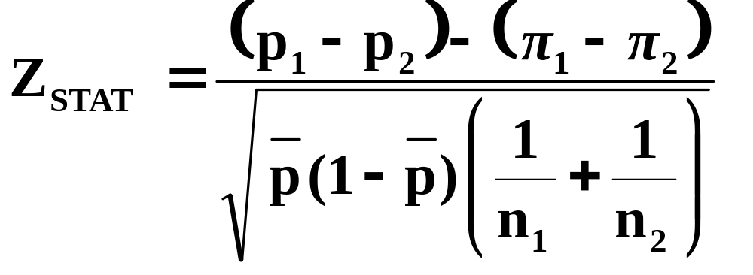
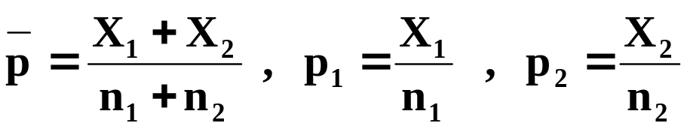
Two Population Proportions
(continued)
The test statistic for
π₁ – π₂ is a Z statistic:
DCOVA
Population proportions
where

Slide 31
Hypothesis Tests for
Two Population Proportions
DCOVA
Population proportions
Lower-tail test:
H₀: π₁ ≥ π₂
H₁: π₁ < π₂
i.e.,
H₀: π₁ – π₂ ≥ 0
H₁: π₁ – π₂ < 0
Upper-tail test:
H₀: π₁ ≤ π₂
H₁: π₁ > π₂
i.e.,
H₀: π₁ – π₂ ≤ 0
H₁: π₁ – π₂ > 0
Two-tail test:
H₀: π₁ = π₂
H₁: π₁ ≠ π₂
i.e.,
H₀: π₁ – π₂ = 0
H₁: π₁ – π₂ ≠ 0

Slide 32
Hypothesis Tests for
Two Population Proportions
(continued)
Population proportions
DCOVA
Lower-tail test:
H₀: π₁ – π₂ ≥ 0
H₁: π₁ – π₂ < 0
Upper-tail test:
H₀: π₁ – π₂ ≤ 0
H₁: π₁ – π₂ > 0
Two-tail test:
H₀: π₁ – π₂ = 0
H₁: π₁ – π₂ ≠ 0
α
α
α/2
α/2
-z_{α}
z_{α}
-z_{α/2}
z_{α/2}
Reject H₀ if Z_{STAT} < -Z_{α}
Reject H₀ if Z_{STAT} > Z_{α}
Reject H₀ if Z_{STAT} < -Z_{α/2}
or Z_{STAT} > Z_{α/2}

Slide 33

Hypothesis Test Example:
Two population Proportions
DCOVA
Is there a significant difference between the proportion of men and the proportion of women who will vote Yes on Proposition A?
In a random sample, 36 of 72 men and 35 of 50 women indicated they would vote Yes
Test at the .05 level of significance

Slide 34
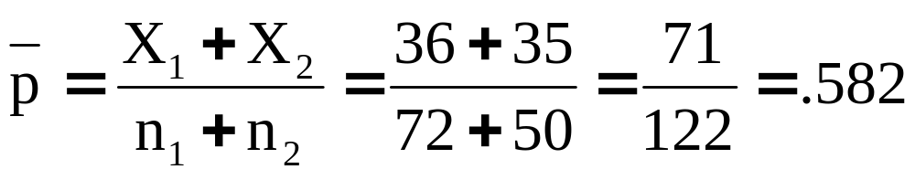
Hypothesis Test Example:
Two population Proportions
(continued)
DCOVA
The hypothesis test is:
H₀: π₁ – π₂ = 0 (the two proportions are equal)
H₁: π₁ – π₂ ≠ 0 (there is a significant difference between proportions)
The sample proportions are:
  Men: p₁ = 36/72 = 0.50
  Women: p₂ = 35/50 = 0.70
The pooled estimate for the overall proportion is:

Slide 35
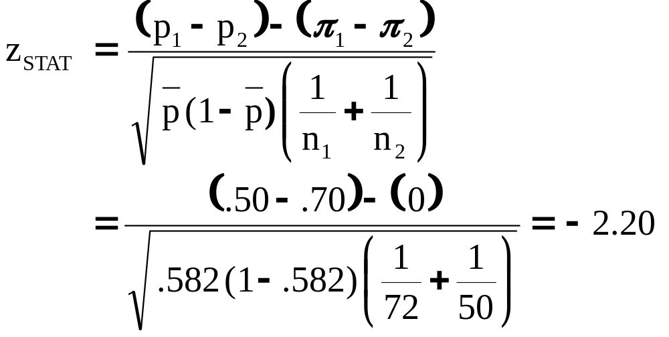
Hypothesis Test Example:
Two Population Proportions
(continued)
DCOVA
Reject H₀
Reject H₀
The test statistic for π₁ – π₂ is:
.025
.025
-1.96
1.96
-2.20
Decision: Reject H₀
Conclusion: There is evidence of a significant difference in the proportion of men and women who will vote yes.
Critical Values = ±1.96
For α = .05

Slide 36
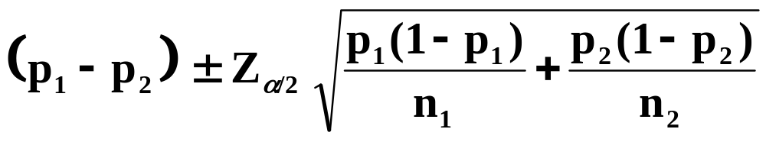
Confidence Interval for
Two Population Proportions
DCOVA
Population proportions
The confidence interval for
π₁ – π₂ is:

Slide 37
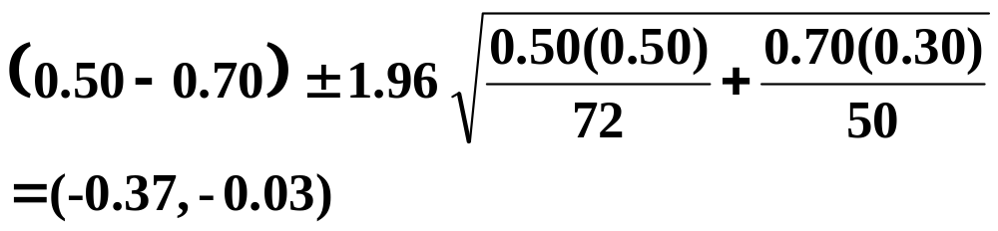
Confidence Interval for Two Population Proportions -- Example
DCOVA
The 95% confidence interval for π₁ – π₂ is:
Since this interval does not contain 0 can be 95% confident the two proportions are different.

Slide 38
Testing for the Ratio Of Two Population Variances
DCOVA
Hypotheses F_{STAT}
*
Tests for Two
Population
Variances
H₀: σ₁² = σ₂²
H₁: σ₁² ≠ σ₂²
S₁² / S₂²
H₀: σ₁² ≤ σ₂²
H₁: σ₁² > σ₂²
F test statistic
Where:
S₁² = Variance of sample 1 (the larger sample variance)
n₁ = sample size of sample 1
S₂² = Variance of sample 2 (the smaller sample variance)
n₂ = sample size of sample 2
n₁ –1 = numerator degrees of freedom
n₂ – 1 = denominator degrees of freedom

Slide 39
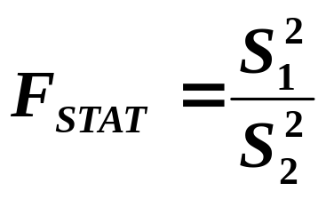
The F Distribution
DCOVA
The F critical value is found from the F table
There are two degrees of freedom required: numerator and denominator
The larger sample variance is always the numerator
When
In the F table,
  numerator degrees of freedom determine the column
  denominator degrees of freedom determine the row
df₁ = n₁ – 1 ; df₂ = n₂ – 1

Slide 40
Finding the Rejection Region
DCOVA
H₀: σ₁² = σ₂²
H₁: σ₁² ≠ σ₂²
H₀: σ₁² ≤ σ₂²
H₁: σ₁² > σ₂²
α/2
F
α
0
0
F
Do not
reject H₀
F_{α/2}
Reject H₀
Do not
reject H₀
F_{α}
Reject H₀
Reject H₀ if F_{STAT} > F_{α/2}
Reject H₀ if F_{STAT} > F_{α}

Slide 41
F Test: An Example
DCOVA
You are a financial analyst for a brokerage firm. You want to compare dividend yields between stocks listed on the NYSE & NASDAQ. You collect the following data:
NYSE NASDAQ
Number 21 25
Mean 3.27 2.53
Std dev 1.30 1.16
Is there a difference in the variances between the NYSE & NASDAQ at the α = 0.05 level?

Slide 42
F Test: Example Solution
DCOVA
Form the hypothesis test:
  H₀: σ²₁ = σ²₂ (there is no difference between variances)
  H₁: σ²₁ ≠ σ²₂ (there is a difference between variances)
Find the F critical value for α = 0.05:
Numerator d.f. = n₁ – 1 = 21 –1 =20
Denominator d.f. = n₂ – 1 = 25 –1 = 24
F_{α/2} = F_{.025, 20, 24} = 2.33

Slide 43
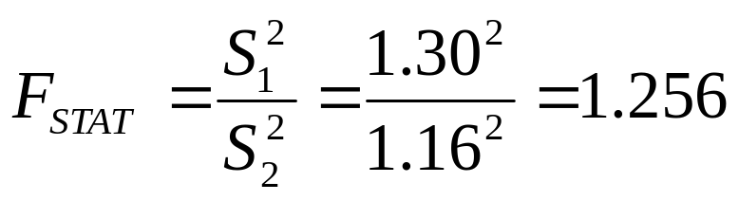
F Test: Example Solution
DCOVA
(continued)
The test statistic is:
H₀: σ₁² = σ₂²
H₁: σ₁² ≠ σ₂²
α/2 = .025
0
F
Do not
reject H₀
Reject H₀
F_{0.025}=2.33
F_{STAT} = 1.256 is not in the rejection region, so we do not reject H₀
Conclusion: There is not sufficient evidence of a difference in variances at α = .05

Slide 44
General ANOVA Setting
DCOVA
Investigator controls one or more factors of interest
  Each factor contains two or more levels
  Levels can be numerical or categorical
  Different levels produce different groups
  Think of each group as a sample from a different population
Observe effects on the dependent variable
  Are the groups the same?
Experimental design: the plan used to collect the data

Slide 45
Completely Randomized Design
DCOVA
Experimental units (subjects) are assigned randomly to groups
  Subjects are assumed homogeneous
Only one factor or independent variable
  With two or more levels
Analyzed by one-factor analysis of variance (ANOVA)

Slide 46
One-Way Analysis of Variance
DCOVA
Evaluate the difference among the means of three or more groups
  Examples: Number of accidents for 1st, 2nd, and 3rd shift
  Expected mileage for five brands of tires
Assumptions
  Populations are normally distributed
  Populations have equal variances
  Samples are randomly and independently drawn

Slide 47
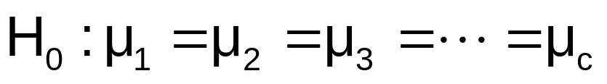
Hypotheses of One-Way ANOVA
DCOVA
  All population means are equal
  i.e., no factor effect (no variation in means among groups)
  At least one population mean is different
  i.e., there is a factor effect
  Does not mean that all population means are different (some pairs may be the same)

Slide 48
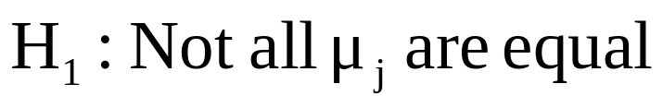
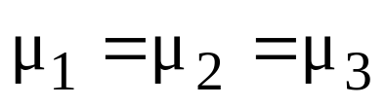
One-Way ANOVA
DCOVA
When The Null Hypothesis is True
All Means are the same:
(No Factor Effect)

Slide 49
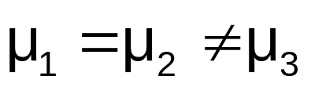
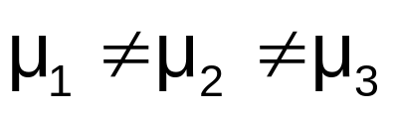
One-Way ANOVA
(continued)
DCOVA
When The Null Hypothesis is NOT true
At least one of the means is different
(Factor Effect is present)
or

Slide 50
Partitioning the Variation
DCOVA
Total variation can be split into two parts:
SST = SSA + SSW
SST = Total Sum of Squares
(Total variation)
SSA = Sum of Squares Among Groups
(Among-group variation)
SSW = Sum of Squares Within Groups
(Within-group variation)

Slide 51
Partitioning the Variation
(continued)
DCOVA
SST = SSA + SSW
Total Variation = the aggregate variation of the individual data values across the various factor levels (SST)
Among-Group Variation = variation among the factor sample means (SSA)
Within-Group Variation = variation that exists among the data values within a particular factor level (SSW)

Slide 52
Partition of Total Variation
DCOVA
Total Variation (SST)
=
Variation Due to Factor (SSA)
+
Variation Due to Random Error (SSW)

Slide 53
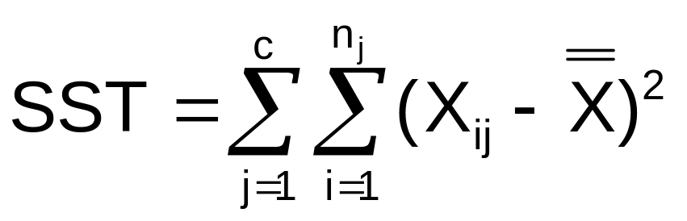

Total Sum of Squares
DCOVA
SST = SSA + SSW
Where:
SST = Total sum of squares
c = number of groups or levels
n_{j} = number of values in group j
X_{ij} = i^{th} observation from group j
X = grand mean (mean of all data values)

Slide 54
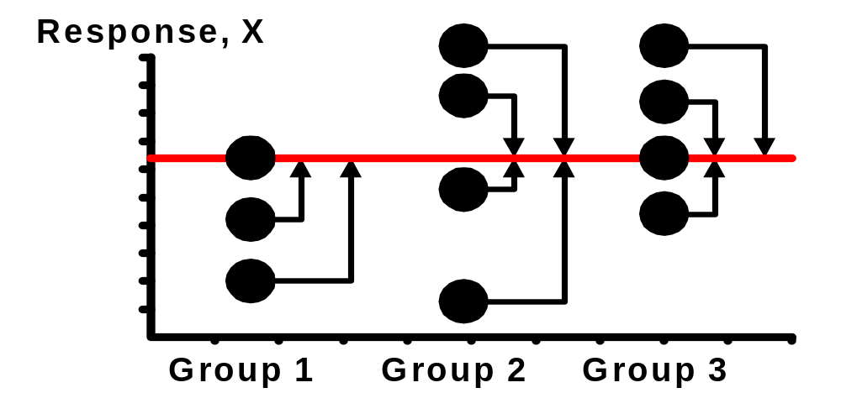
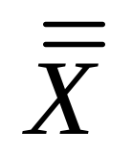
Total Variation
DCOVA
(continued)

Slide 55
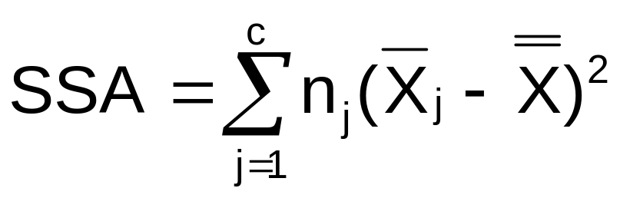
Among-Group Variation
DCOVA
SST = SSA + SSW
Where:
SSA = Sum of squares among groups
c = number of groups
n_{j} = sample size from group j
X_{j} = sample mean from group j
X = grand mean (mean of all data values)

Slide 56
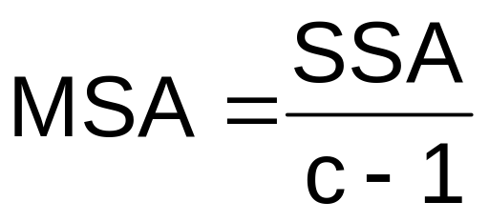


Among-Group Variation
(continued)
DCOVA
Variation Due to
Differences Among Groups
Mean Square Among = SSA/degrees of freedom

Slide 57
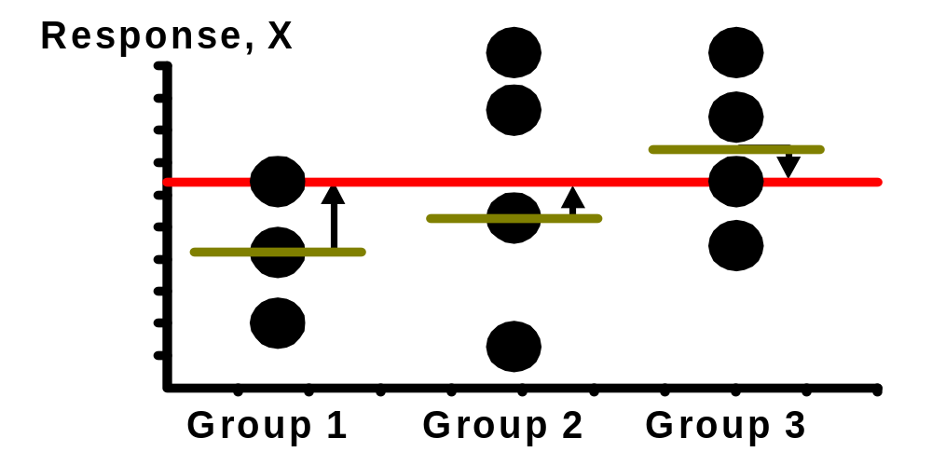
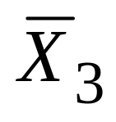
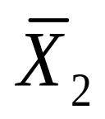
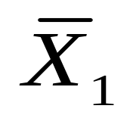
Among-Group Variation
DCOVA
(continued)

Slide 58
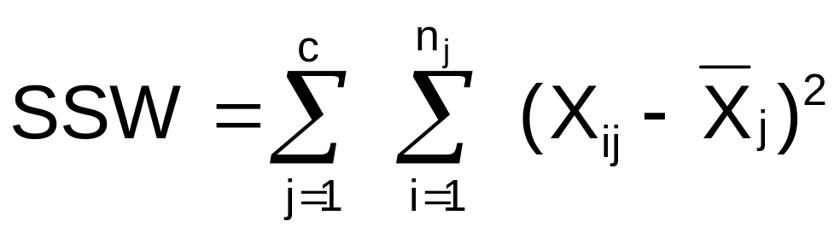
Within-Group Variation
DCOVA
SST = SSA + SSW
Where:
SSW = Sum of squares within groups
c = number of groups
n_{j} = sample size from group j
X_{j} = sample mean from group j
X_{ij} = i^{th} observation in group j

Slide 59
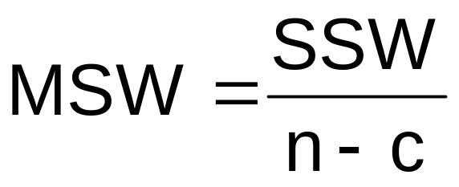

Within-Group Variation
(continued)
DCOVA
Summing the variation within each group and then adding over all groups
Mean Square Within = SSW/degrees of freedom

Slide 60
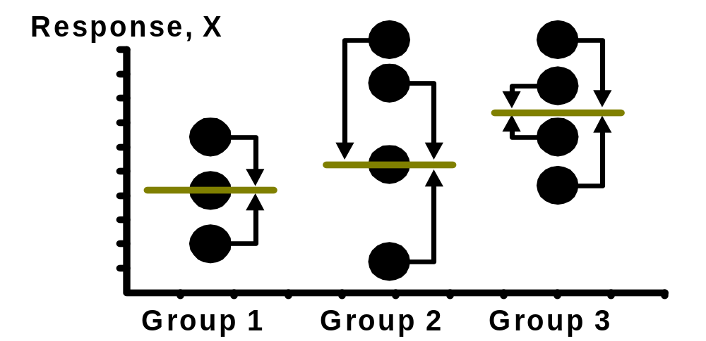
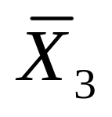
Within-Group Variation
DCOVA
(continued)

Slide 61

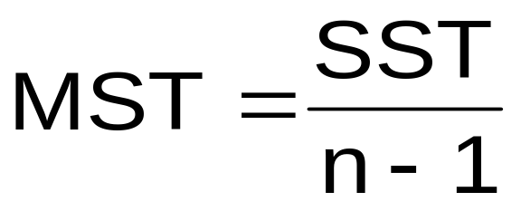
Obtaining the Mean Squares
DCOVA
The Mean Squares are obtained by dividing the various sum of squares by their associated degrees of freedom
Mean Square Among
(d.f. = c-1)
Mean Square Within
(d.f. = n-c)
Mean Square Total
(d.f. = n-1)

Slide 62
One-Way ANOVA Table
DCOVA
Source of Variation
Degrees of
Freedom
Sum Of
Squares
Mean Square
(Variance)
F
Among Groups
SSA
F_{STAT} =
c - 1
SSA
MSA =
c - 1
MSA
Within Groups
SSW
n - c
SSW
MSW =
MSW
n - c
Total
n – 1
SST
c = number of groups
n = sum of the sample sizes from all groups
df = degrees of freedom

Slide 63

One-Way ANOVA
F Test Statistic
DCOVA
H₀: μ₁= μ₂ = … = μ_{c}
H₁: At least two population means are different
Test statistic
    MSA is mean squares among groups
    MSW is mean squares within groups
Degrees of freedom
  df₁ = c – 1 (c = number of groups)
  df₂ = n – c (n = sum of sample sizes from all populations)

Slide 64
Interpreting One-Way ANOVA
F Statistic
DCOVA
The F statistic is the ratio of the among estimate of variance and the within estimate of variance
  The ratio must always be positive
  df₁ = c -1 will typically be small
  df₂ = n - c will typically be large
Decision Rule:
Reject H₀ if F_{STAT} > F_{α}, otherwise do not reject H₀
α
0
Do not
reject H₀
Reject H₀
F_{α}

Slide 65
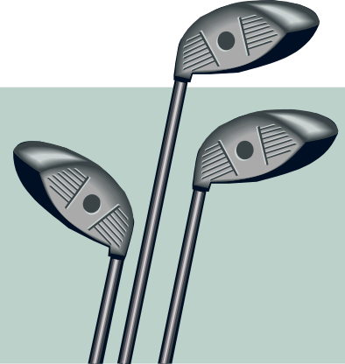

One-Way ANOVA
F Test Example
DCOVA
You want to see if three different golf clubs yield different distances. You randomly select five measurements from trials on an automated driving machine for each club. At the 0.05 significance level, is there a difference in mean distance?
Club 1 Club 2 Club 3
254 234 200
263 218 222
241 235 197
237 227 206
251 216 204

Slide 66
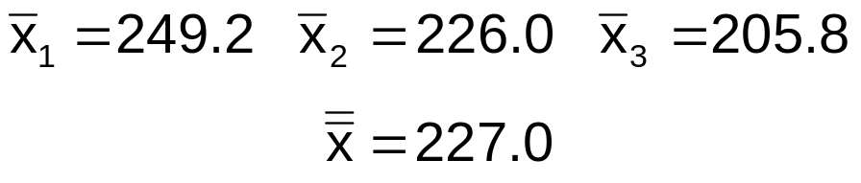
One-Way ANOVA Example:
Scatter Plot
DCOVA
Distance
Club 1 Club 2 Club 3
254 234 200
263 218 222
241 235 197
237 227 206
251 216 204
270
260
250
240
230
220
210
200
190
•
•
•
•
•
•
•
•
•
•
•
•
•
•
•
1 2 3
Club

Slide 67
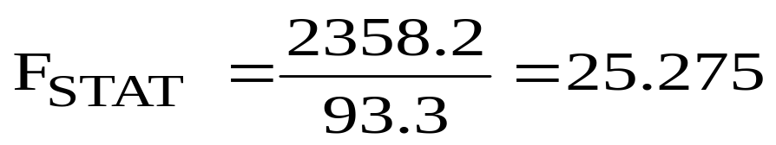
One-Way ANOVA Example Computations
DCOVA
Club 1 Club 2 Club 3
254 234 200
263 218 222
241 235 197
237 227 206
251 216 204
X₁ = 249.2
X₂ = 226.0
X₃ = 205.8
X = 227.0
n₁ = 5
n₂ = 5
n₃ = 5
n = 15
c = 3
SSA = 5 (249.2 – 227)² + 5 (226 – 227)² + 5 (205.8 – 227)² = 4716.4
SSW = (254 – 249.2)² + (263 – 249.2)² +…+ (204 – 205.8)² = 1119.6
MSA = 4716.4 / (3-1) = 2358.2
MSW = 1119.6 / (15-3) = 93.3

Slide 68
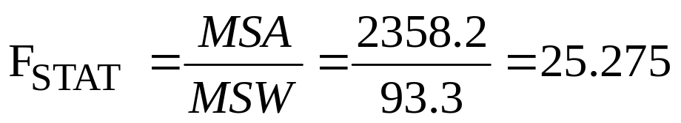
One-Way ANOVA Example Solution
DCOVA
H₀: μ₁ = μ₂ = μ₃
H₁: μ_{j} not all equal
α = 0.05
df₁= 2 df₂ = 12
Test Statistic:
Decision:
Conclusion:
Critical Value:
F_{α} = 3.89
Reject H₀ at α = 0.05
α = .05
There is evidence that at least one μ_{j} differs from the rest
0
Do not
reject H₀
Reject H₀
F_{0.05} = 3.89

Slide 69
One-Way ANOVA
Excel Output
DCOVA
SUMMARY
Groups | Count | Sum | Average | Variance
Club 1 | 5 | 1246 | 249.2 | 108.2
Club 2 | 5 | 1130 | 226 | 77.5
Club 3 | 5 | 1029 | 205.8 | 94.2
ANOVA
Source of Variation | SS | df | MS | F | P-value | F crit
Between Groups | 4716.4 | 2 | 2358.2 | 25.275 | 0.0000 | 3.89
Within Groups | 1119.6 | 12 | 93.3
Total | 5836.0 | 14

Slide 70
One-Way ANOVA
Minitab Output
DCOVA
One-way ANOVA: Distance versus Club
Source DF SS MS F P
Club 2 4716.4 2358.2 25.28 0.000
Error 12 1119.6 93.3
Total 14 5836.0
S = 9.659 R-Sq = 80.82% R-Sq(adj) = 77.62%
Individual 95% CIs For Mean Based on Pooled StDev
Level N Mean StDev -------+---------+---------+---------+--
1 5 249.20 10.40 (-----*-----)
2 5 226.00 8.80 (-----*-----)
3 5 205.80 9.71 (-----*-----)
-------+---------+---------+---------+--
208 224 240 256
Pooled StDev = 9.66

Slide 71
ANOVA Assumptions
DCOVA
Randomness and Independence
  Select random samples from the c groups (or randomly assign the levels)
Normality
  The sample values for each group are from a normal population
Homogeneity of Variance
  All populations sampled from have the same variance
  Can be tested with Levene’s Test

Slide 72
ANOVA Assumptions
Levene’s Test
DCOVA
Tests the assumption that the variances of each population are equal.
First, define the null and alternative hypotheses:
  H₀: σ²₁ = σ²₂ = …=σ²_{c}
  H₁: Not all σ²_{j} are equal
Second, compute the absolute value of the difference between each value and the median of each group.
Third, perform a one-way ANOVA on these absolute differences.

Slide 73
Levene Homogeneity Of Variance Test Example
DCOVA
  H0: σ²₁ = σ²₂ = σ²₃
  H1: Not all σ²_{j} are equal
Calculate Medians
Club 1 | Club 2 | Club 3
237 | 216 | 197
241 | 218 | 200
251 | 227 | 204 | Median
254 | 234 | 206
263 | 235 | 222
Calculate Absolute Differences
Club 1 | Club 2 | Club 3
14 | 11 | 7
10 | 9 | 4
0 | 0 | 0
3 | 7 | 2
12 | 8 | 18

Slide 74
Levene Homogeneity Of Variance Test Example
(continued)
DCOVA
Anova: Single Factor
SUMMARY
Groups | Count | Sum | Average | Variance
Club 1 | 5 | 39 | 7.8 | 36.2
Club 2 | 5 | 35 | 7 | 17.5
Club 3 | 5 | 31 | 6.2 | 50.2
Since the p-value is greater than 0.05 there is insufficient evidence of a difference in the variances
Source of Variation | SS | df | MS | F | P-value | F crit
Between Groups | 6.4 | 2 | 3.2 | 0.092 | 0.912 | 3.885
Within Groups | 415.6 | 12 | 34.6
Total | 422 | 14

Slide 75
The Tukey-Kramer Procedure
DCOVA
Tells which population means are significantly different
  e.g.: μ₁ = μ₂ ≠ μ₃
  Done after rejection of equal means in ANOVA
Allows paired comparisons
  Compare absolute mean differences with critical range
μ
=
μ
μ
x
1
2
3

Slide 76
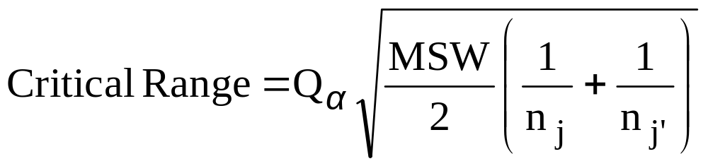
Tukey-Kramer Critical Range
DCOVA
where:
Q_{α} = Upper Tail Critical Value from Studentized Range Distribution with c and n - c degrees of freedom (see appendix E.7 table)
MSW = Mean Square Within
n_{j} and n_{j’} = Sample sizes from groups j and j’

Slide 77


The Tukey-Kramer Procedure: Example
DCOVA
1. Compute absolute mean differences:
Club 1 Club 2 Club 3
254 234 200
263 218 222
241 235 197
237 227 206
251 216 204
2. Find the Q_{α} value from the table in appendix E.7 with
c = 3 and (n – c) = (15 – 3) = 12 degrees of freedom:

Slide 78


The Tukey-Kramer Procedure: Example
(continued)
3. Compute Critical Range:
DCOVA
4. Compare:
5. All of the absolute mean differences are greater than the critical range. Therefore there is a significant difference between each pair of means at 5% level of significance.
Thus, with 95% confidence we conclude that the mean distance for club 1 is greater than club 2 and 3, and club 2 is greater than club 3.

Slide 79
Chapter Summary
In this chapter we discussed:
How to use hypothesis testing for comparing the difference between
  The means of two independent populations
  The means of two related populations
  The proportions of two independent populations
  The variances of two independent populations
  The means of more than two populations

